Slide 1
Arrearage & Disconnection Analysis January - June 2025
Charlee Thompson, NW Energy Coalition

Slide 2
Acronyms and Terminology
AMP = Arrearage Management Plan
Arrearages = Past-due bills
BDR = Bill Discount Rate
CACAP = Crisis-Affected Customer Assistance Program
Census Tracts = Delineated geographic area within zip code
CETA = Clean Energy Transformation Act
Highly Impacted Communities = Communities in census tracts ranking a 9 or 10 on the Dept. of Health's Environmental Health Disparities Map
IOU = Investor-owned utility (PSE, Avista, Cascade Natural Gas, PacifiCorp, Northwest Natural)
KLI = Known Low-Income
LIHEAP = Low-Income Home Energy Assistance Program
UTC = Utility and Transportation Commission

Slide 3
Key Findings

Slide 4
ARREARAGES

Slide 5
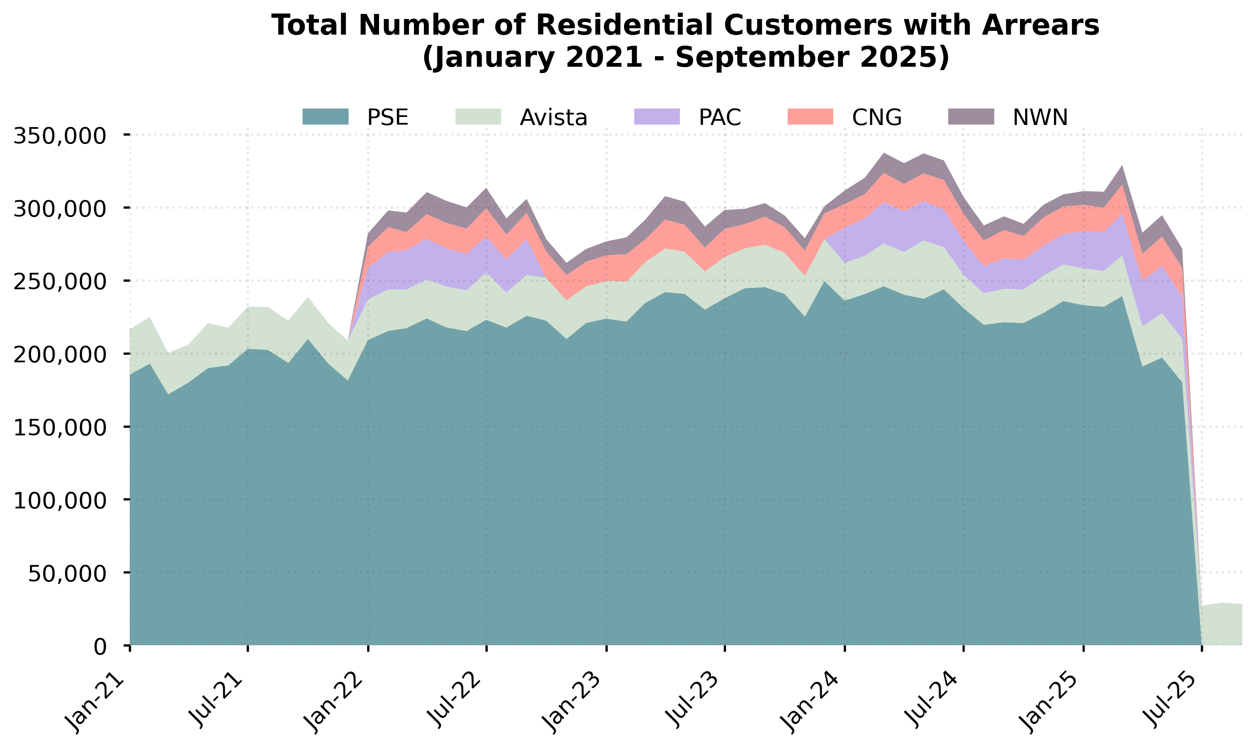
Key findings

Slide 6
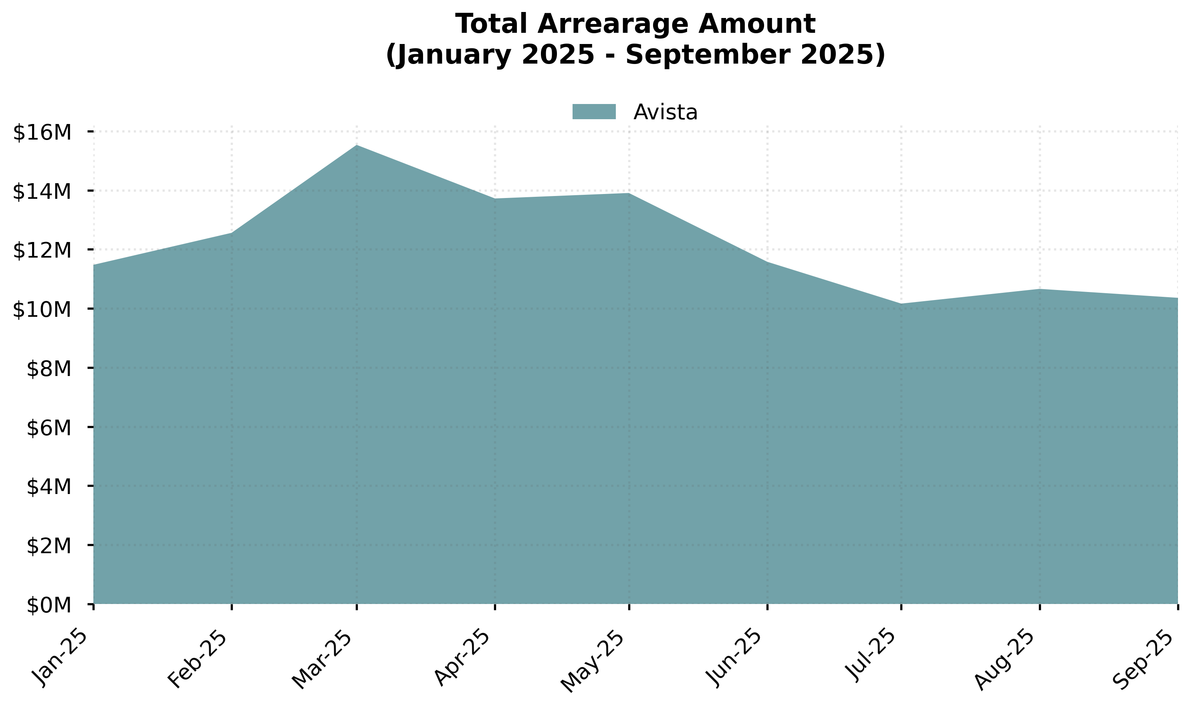
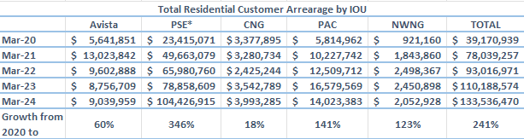
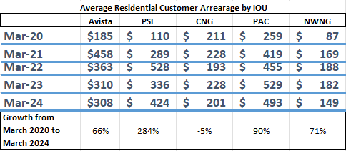
Key findings

Slide 7
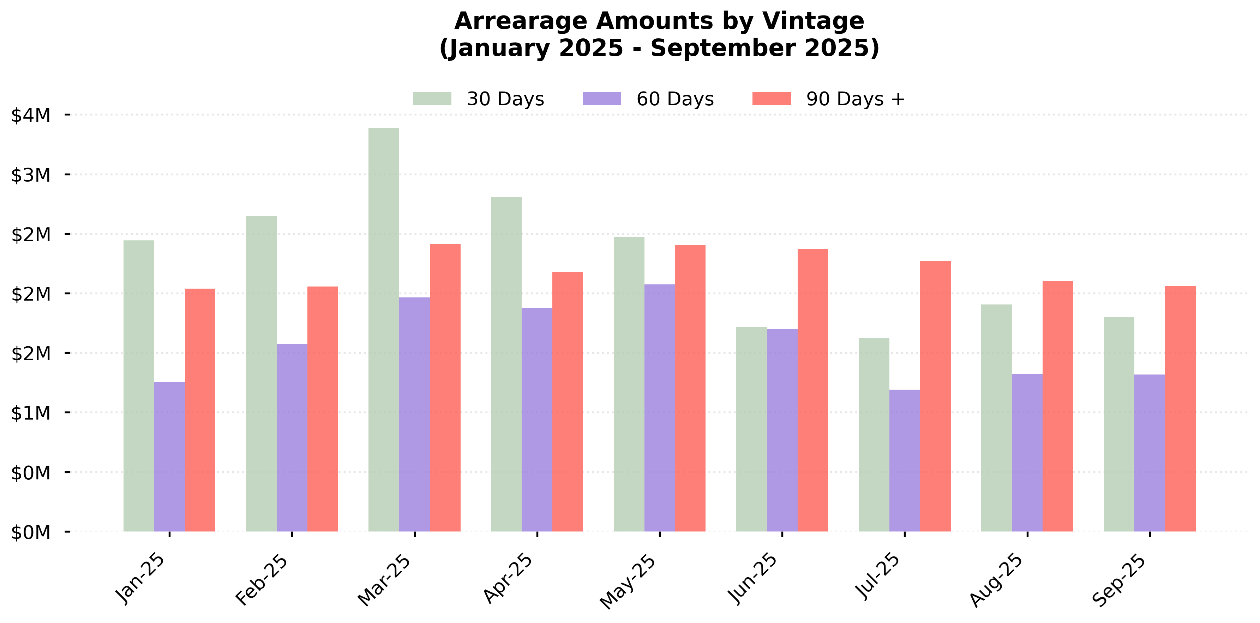
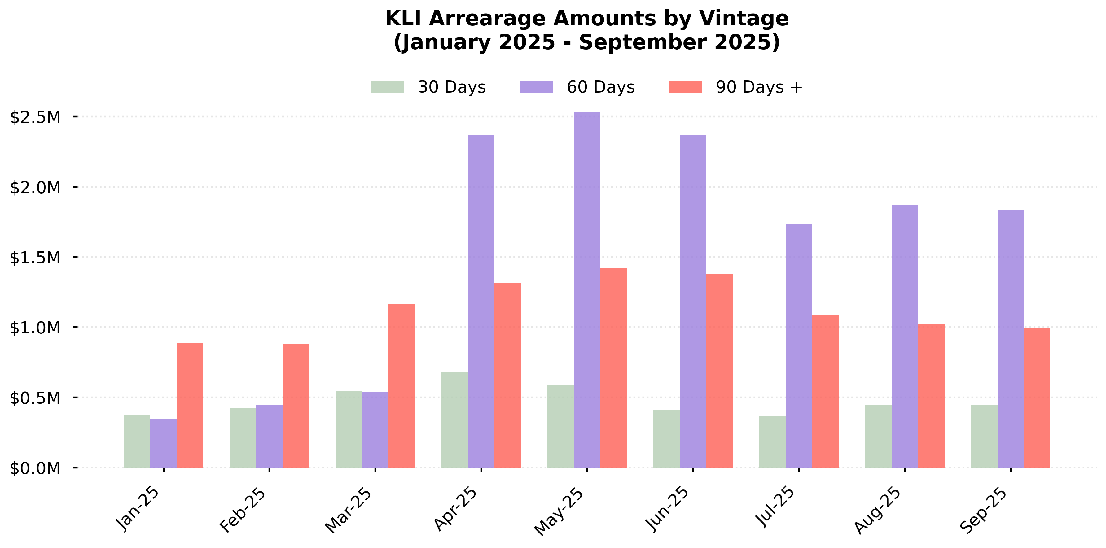
Key findings

Slide 8
Key findings

Slide 9
BILL ASSISTANCE

Slide 10
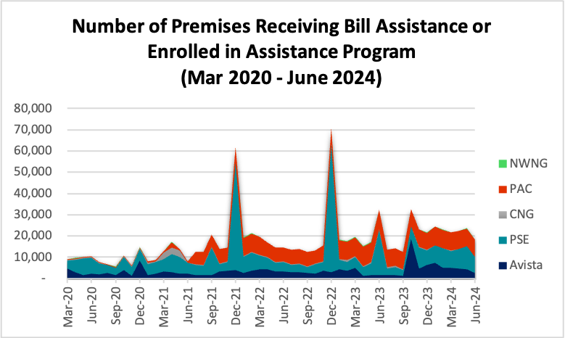
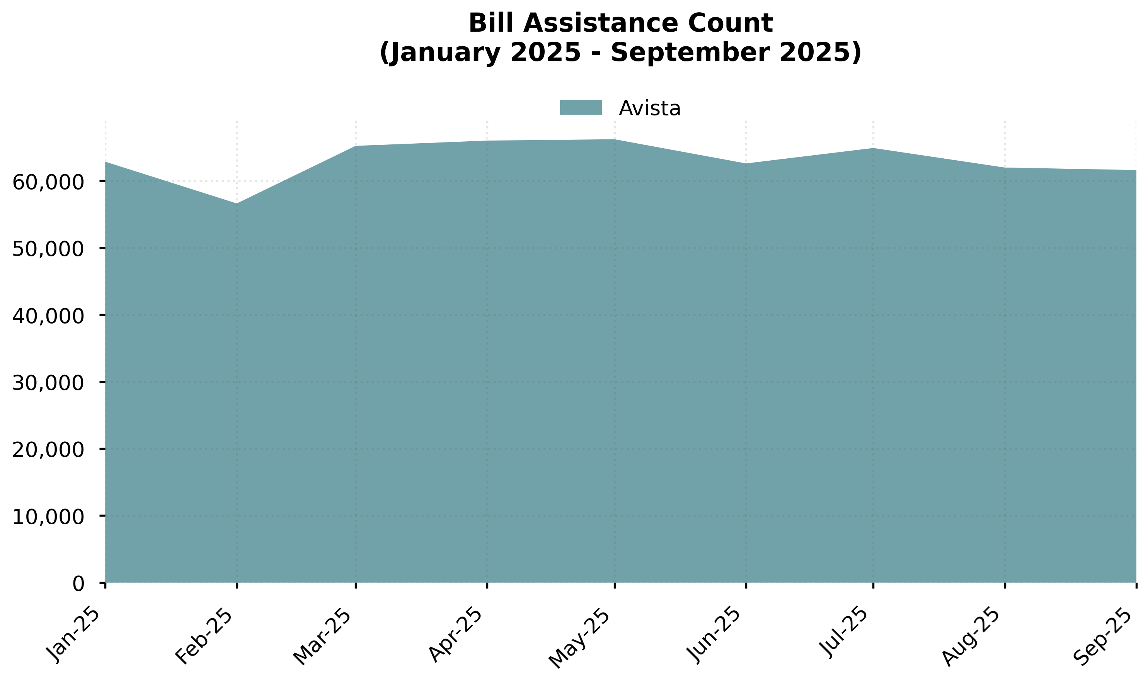
Bill assistance enrollments have increased
PSE had spikes (Dec 2021, 2022) attributed to COVID-19 “CACAP” relief funding.

Slide 11
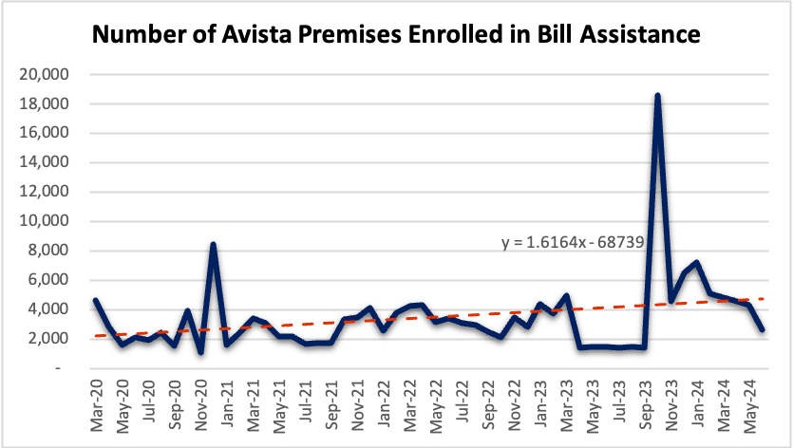
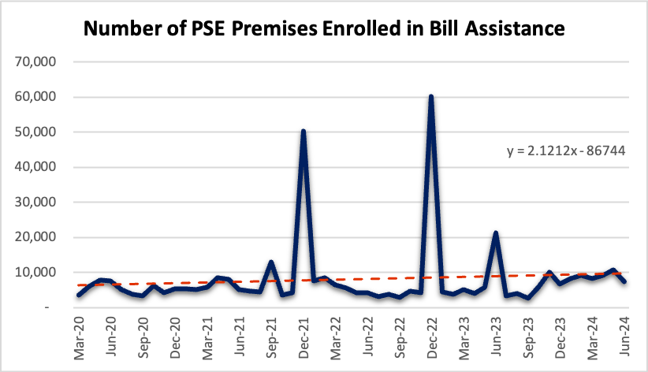
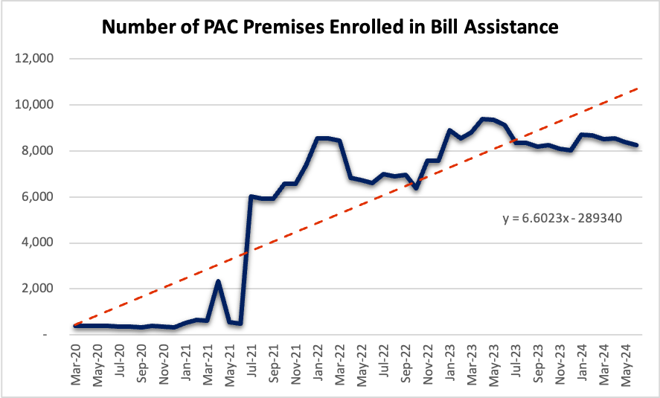
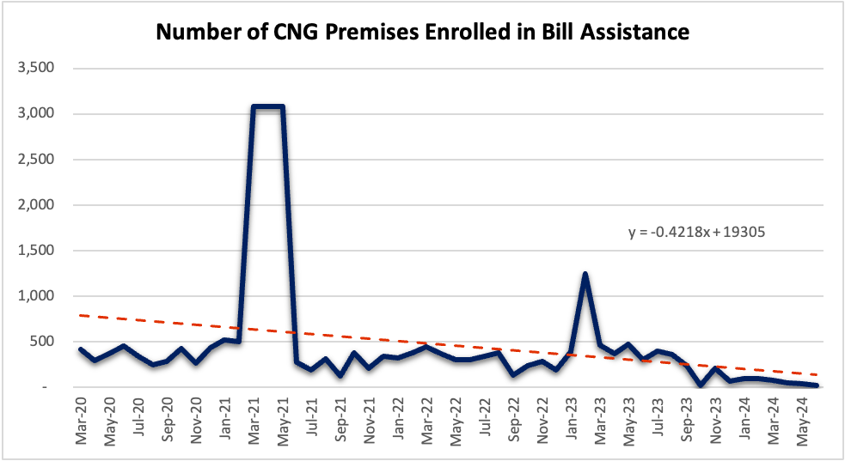
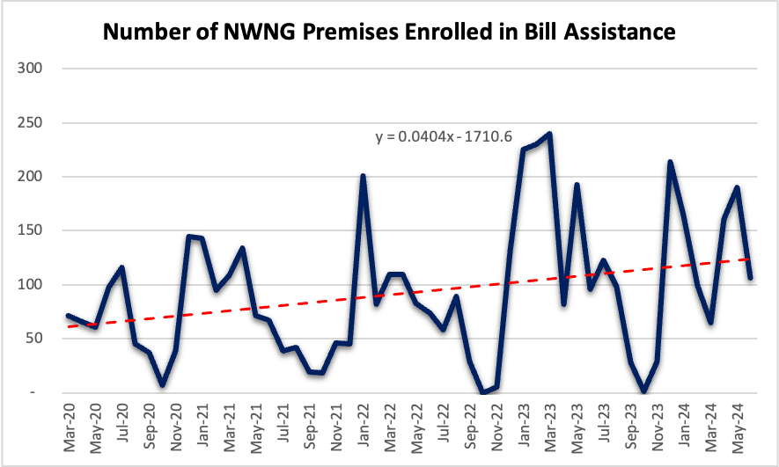
The differences in program enrollment across the IOUs may imply different approaches to program design and outreach, and higher enrollments in the heating season (winter months).
PSE had spikes (Dec 2021, 2022) attributed to COVID-19 “CACAP” relief funding.

Slide 12
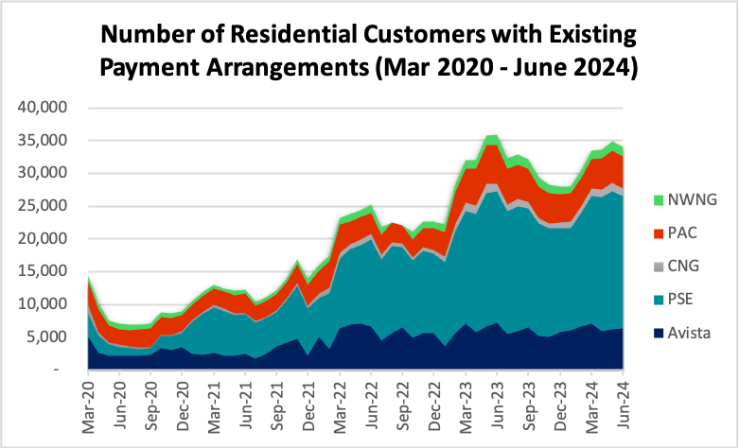
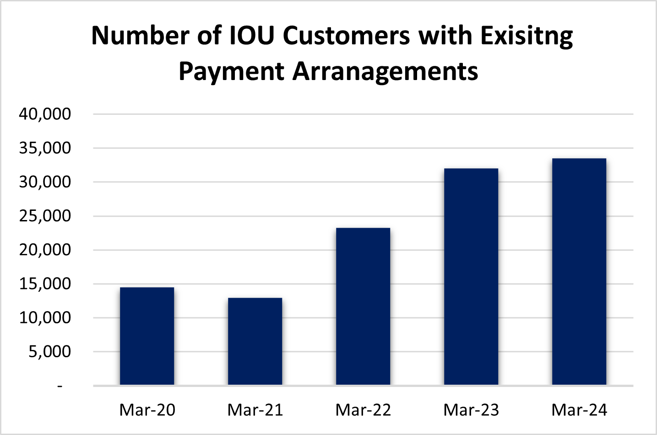
The number of customers with payment arrangements continues to increase across all 5 IOUs.

Slide 13
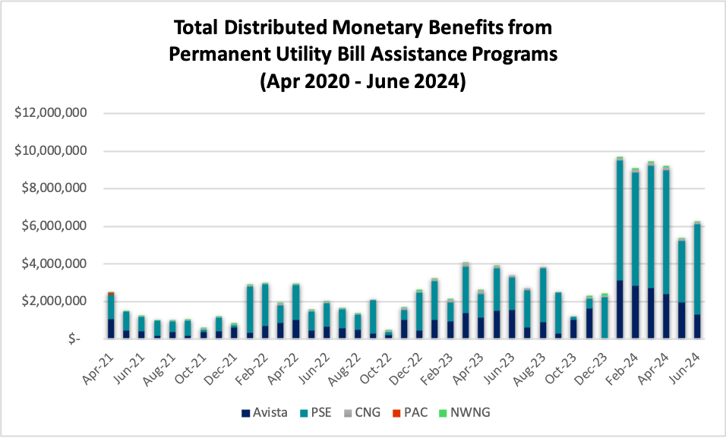
PSE had a significant increase in monetary benefits at the beginning of 2024 due to new enrollments in their grant assistance program (PSE HELP).

Slide 14
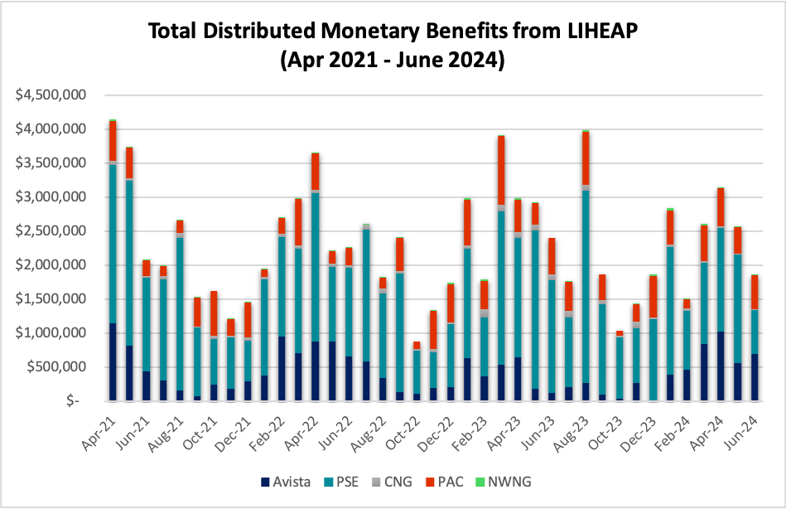
LIHEAP spending has reached upwards of $4 million in a month.

Slide 15
DISCONNECTIONS

Slide 16
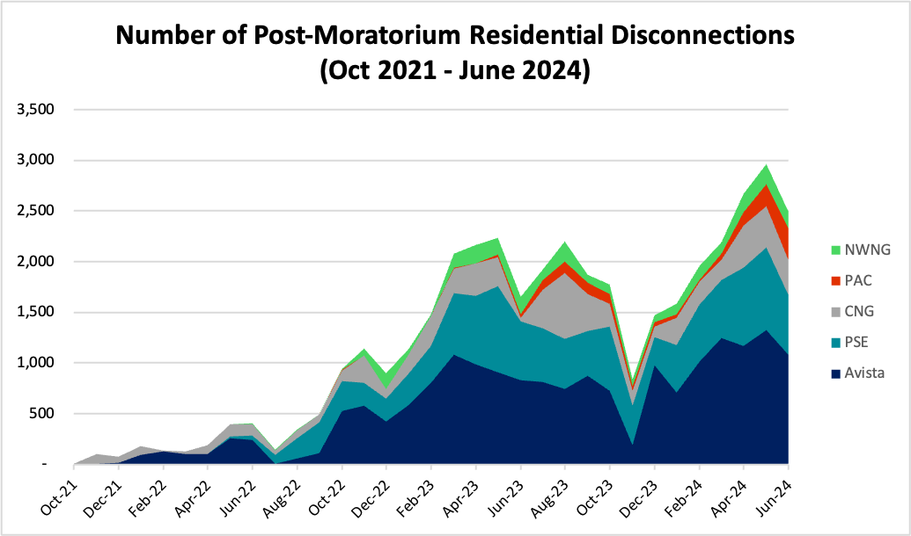
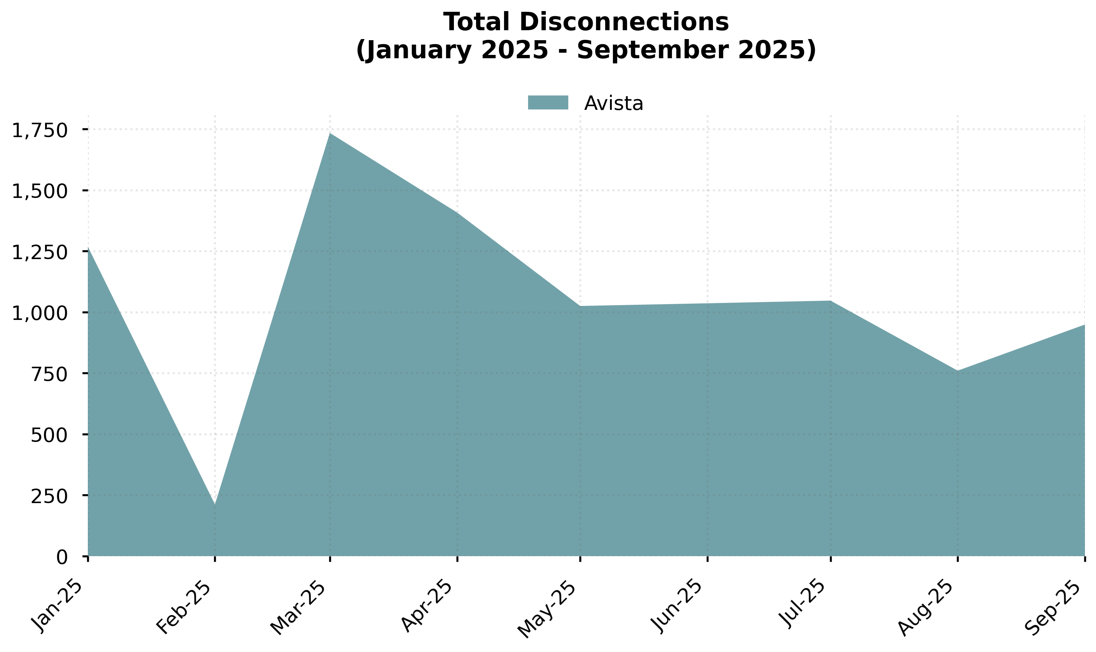
Disconnections after the COVID moratorium ended in Sept 2021 continue to increase.
As PSE gradually decreases its “dunning” threshold from $1000 to $250 through the end of 2024, disconnections may increase further.

Slide 17
COLLECTIONS

Slide 18
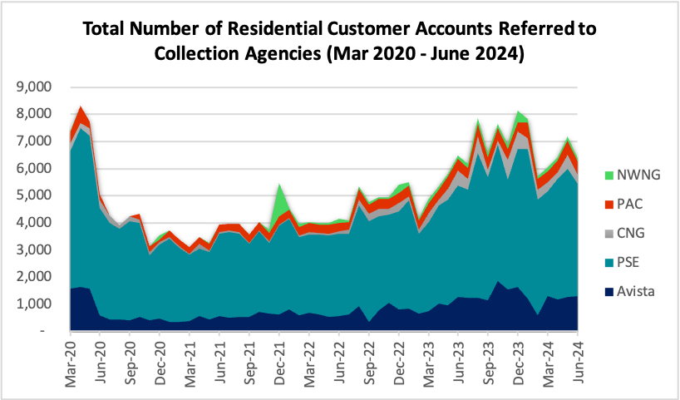
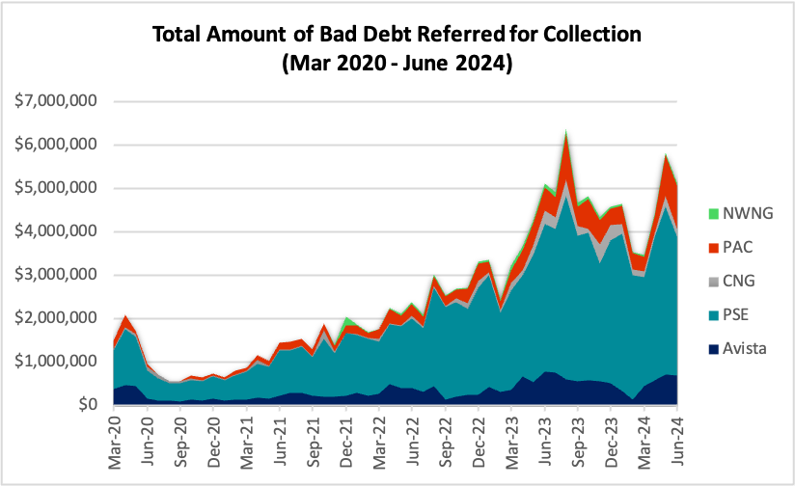
The number of residential customers referred to collection agencies is gradually returning to its peak from early 2020.
The total amount of bad debt referred to collection is increasing.

Slide 19
SOURCES
Washington State Department of Health, Highly Impacted Communities Identification Tools:
https://doh.wa.gov/data-statistical-reports/washington-tracking-network-wtn/climate-projections/clean-energy-transformation-act/ceta-utility-instructions
Washington Department of Health Environmental Health Disparities Map
https://fortress.wa.gov/doh/wtnibl/WTNIBL/
Washington Utilities and Transportation Commission, Docket Set U-200281
https://www.utc.wa.gov/casedocket/2020/200281/docsets

Slide 20
APPENDIX
Notes:
Insert visuals from the ”credit collection” tab

Slide 21
Bill Assistance Programs Reported in IOU Monthly Reports
Puget Sound Energy
Includes: Grant program (PSE HELP)
Excludes: BDR, AMP (which will begin Oct 2024), Donation program
Avista
Includes: BDR, AMP, Grant program ("LIRAP"), Donation program (“Project Share”)
PacifiCorp
PAC is not reporting any programs other than LIHEAP.
Excludes: BDR, Grant program, Donation program. PAC doesn't have an AMP.
Cascade
It is unclear which programs Cascade includes/excludes given that all utility bill assistance is reported as one combined sum.
Northwest Natural
Includes: Grant program (“GREAT”)
Excludes: BDR, Donation program. NWN doesn't have an AMP.

Slide 22
Other Notable Findings
NWN has charged hundreds of dollars of reconnection fees every month since November 2022. They note in their quarterly reports that they will reimburse customers if this happens. Advocates should double check whether NWN reimbursed customers and ask why NWN continues to report this when they aren't supposed to be charging any fees. NWN is the only utility to do this.
Cascade's reported bill assistance enrollments were low since the start of the new BDR and AMP. This doesn't seem to make sense given the higher enrollments Cascade has reported to its Low-Income Advisory Group.

